Slide 1



International Journal of Telecommunications
The second student conference at MUST
Skin Cancer Classification and Segmentation Using Deep Learning
Under Supervision:
Prof.Rania Elgohary
DR. Mohamed Badawi
Presented By:
Mostafa Tarek
Mohamed Ezz
Abd El-Rahman Ahmed
Amr Samir
Nour Ehab

Slide 2


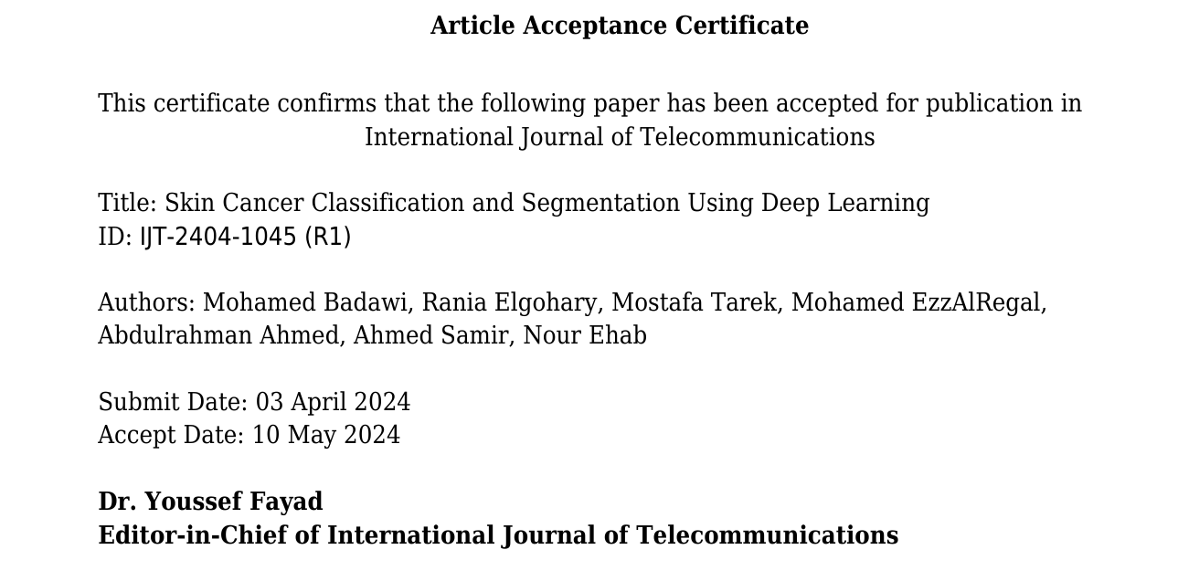
Research Paper
Back to Agenda Page
Paper Acceptance Certificate | Paper QR Code

Slide 3

Introduction
Model Architecture
Problem
Implementation
Related Work
Results
Methodology
Some of predictions
Data Imbalance Solution
Analysis and Conclusion
Data Methodologies
Agenda

Slide 4

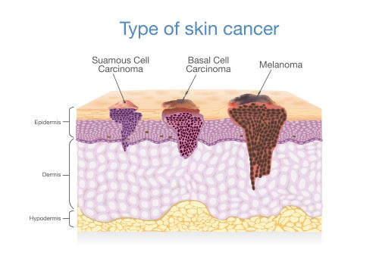
Introduction
Skin cancer is a global health concern, requiring understanding and prevention.
AI offers promise in detection, treatment, and prevention.
Skin cancer includes types like BCC, SCC, and melanoma [1], often diagnosed late.
Back to Agenda Page

Slide 5
Enhancing Skin Cancer Diagnosis Accuracy through Integration of Convolutional Neural Networks and Segmentation Techniques
Skin cancer affects approximately 5.4 million cases globally, with an incidence rate of 3.1% of all cancer cases worldwide. Detecting skin cancer accurately is crucial due to its prevalence and potential for early intervention to improve patient outcomes.
Back to Agenda Page

Slide 6

Related Work
Back to Agenda Page
Deep Learning-Based Skin Lesion Segmentation and Classification of Melanoma Using Support Vector Machine (SVM)
SSD-KD: A Self-Supervised Diverse Knowledge Distillation Method for Lightweight Skin Lesion Classification Using Dermoscopic Images
2023
2023
2022
Light-Dermo: A Lightweight Pretrained Convolution Neural Network for the Diagnosis of Multiclass Skin LesionsLight-Dermo: A Lightweight Pretrained Convolution Neural Network for the Diagnosis of Multiclass Skin Lesions
Comparative Study on Different Deep Learning Models for Skin Lesion Classification Using Transfer Learning Approach
Multi-Class Skin Lesion Classification Using a Lightweight Dynamic Kernel Deep-Learning-Based Convolutional Neural Network
2021
2022
Improved Skin Lesion Recognition by a Self-Supervised Curricular Deep Learning Approach
Multiclass Skin Lesion Localization and Classification Using Deep Learning-Based Features Fusion and Selection Framework for Smart Healthcare
2021
2019

Slide 7
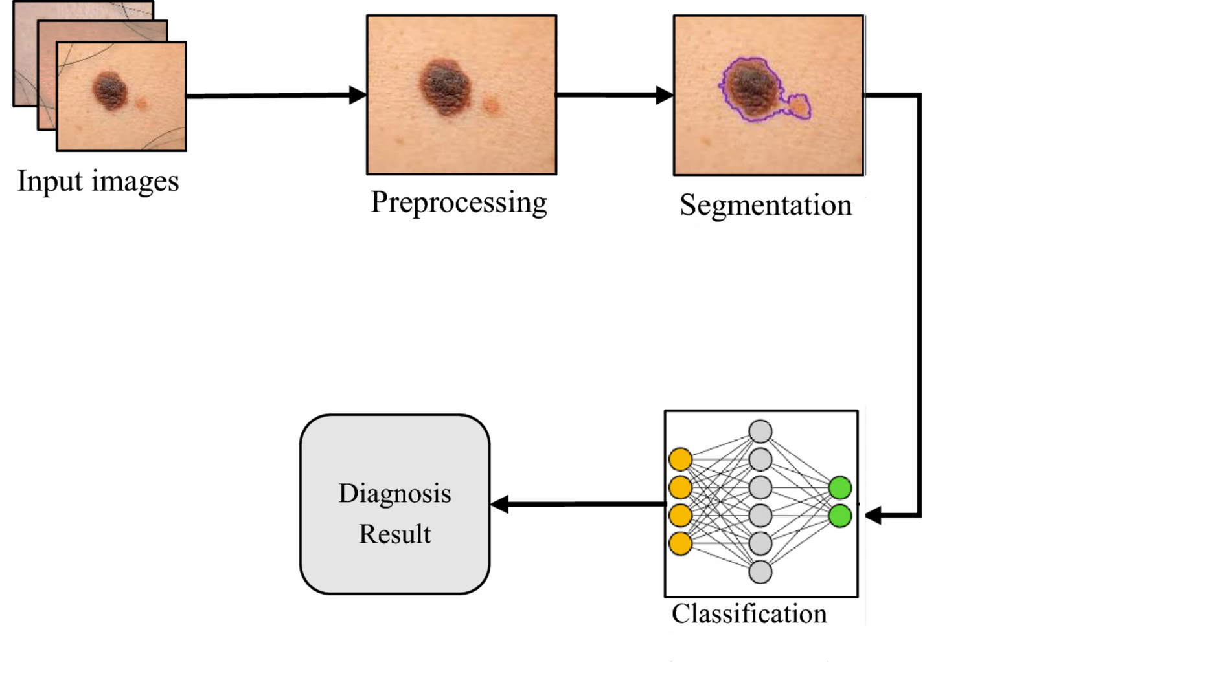
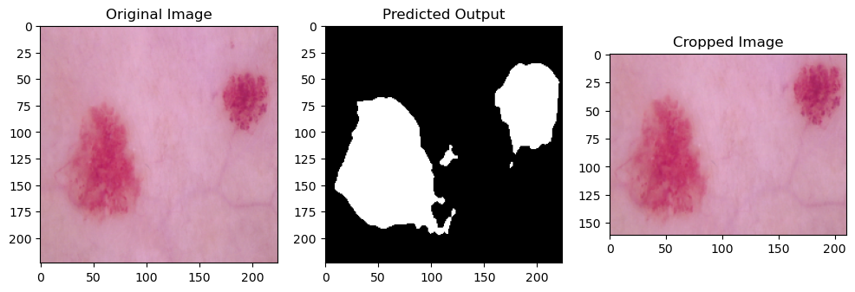
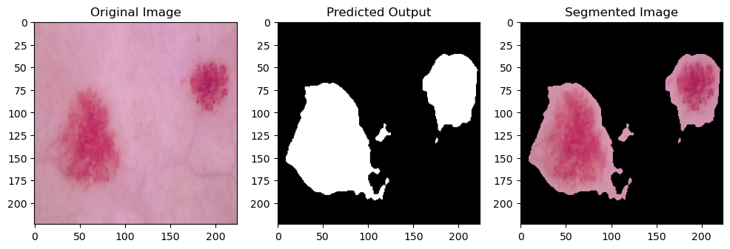
Methodology
Back to Agenda Page
Proposed System | Why need Segmentaion?
 | Noise Reduction, Simplify Analysis, Accurate Features

Slide 8
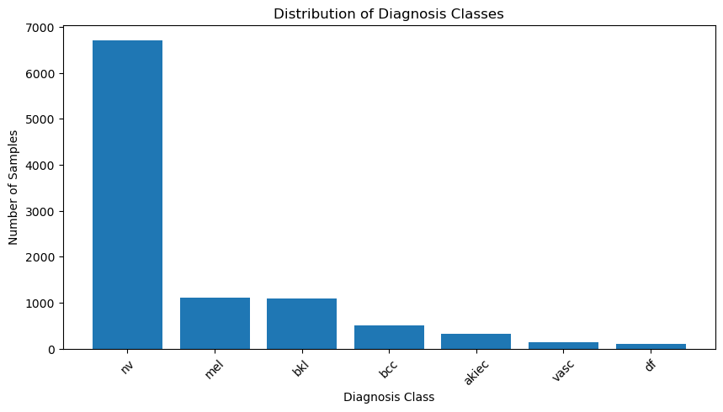
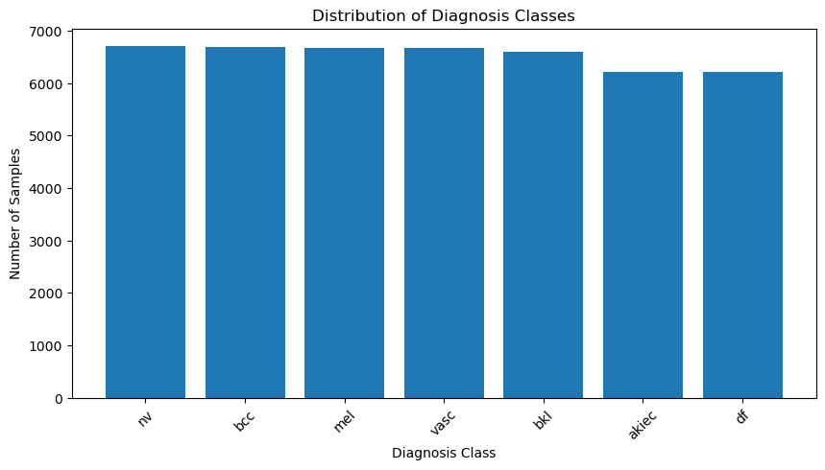
Data Imbalance Solution
Back to Agenda Page
Duplicating images for augmentation purposes
NV class preserved
Augmentation transformations (rotation, shifting, flipping) applied only to the training process

Slide 9
Data Methodologies
Back to Agenda Page
Data Preprocessing Data Augmentaion | Data Preprocessing Data Augmentaion
Classification | Segmentaiton
01
02
01
02
set the image width and height to 28
normalize the data to be from 1 and 0
set the image width and height to 224
Make Batch size to 16
01
02
03
rescaling
Rotation
Shifting
01
02
04
05
Rotation
Flipping
Shearing
Flipping

Slide 10
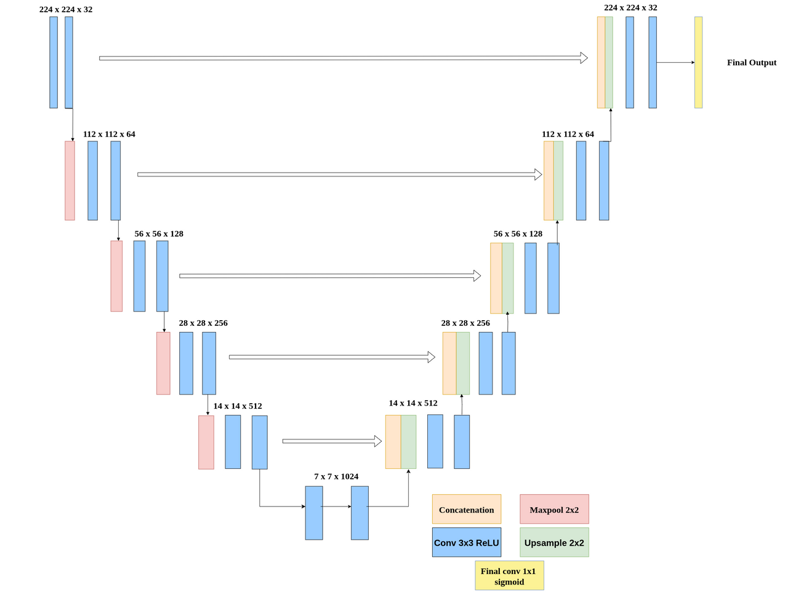
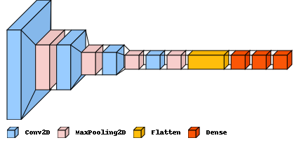
Model Architecture
Back to Agenda Page
HAM10000 Dataset for Classification | PH2 Dataset for Segmentation
Classification | Segmentaiton

Slide 11
Implementation
Back to Agenda Page
Phase 3
Evaluate the results and apply ensemble learning to combine the models.
Phase 2
Build The models, CNN for Classification and U-Net for Segmentation
Phase 1
Data preprocessing for classification and segmentation. Solve problems related to data.

Slide 12
Training and Testing Metrics for Segmention Model
METRICS | ACCURACY | PRECISION | RECALL | DICE COEFFICIENT | IOU
TRAINING | 96.68 | 95.39 | 94.24 | 93.58 | 97.09
TESTING | 96.14 | 93.44 | 94.09 | 92.55 | 96.43
Training and Testing Metrics for Classification Model
TRAINING METRICS
TESTING METRICS | TESTING METRICS | TESTING METRICS | TESTING METRICS
MODEL NAME | ACCURACY | PRECISION | RECALL
MODEL NAME | ACCURACY | PRECISION | RECALL
DEEPCONVNET | 99.5 | 99.5 | 99.5
AUTO ENCODER | 70.17 | 82.26 | 58.09
CNN DECAY LR | 81.23 | 89.72 | 73.28
VGG16 | 67.13 | 84.03 | 54.65
RESNET50 | 66.99 | 66.99 | 66.99
INCEPTIONV3 | 66.97 | 85.86 | 54.2
XCEPTION | 66.8 | 85.92 | 54.31
DEEPCONVNET | 97.204 | 97.5 | 97.2
AUTO ENCODER | 70.17 | 82.49 | 58.17
CNN DECAY LR | 73.64 | 81.1 | 67.9
VGG16 | 66.99 | 83.52 | 60.03
RESNET50 | 66.83 | 66.83 | 66.83
INCEPTIONV3 | 66.89 | 85.19 | 60.58
XCEPTION | 66.73 | 83.29 | 61.04

Slide 13

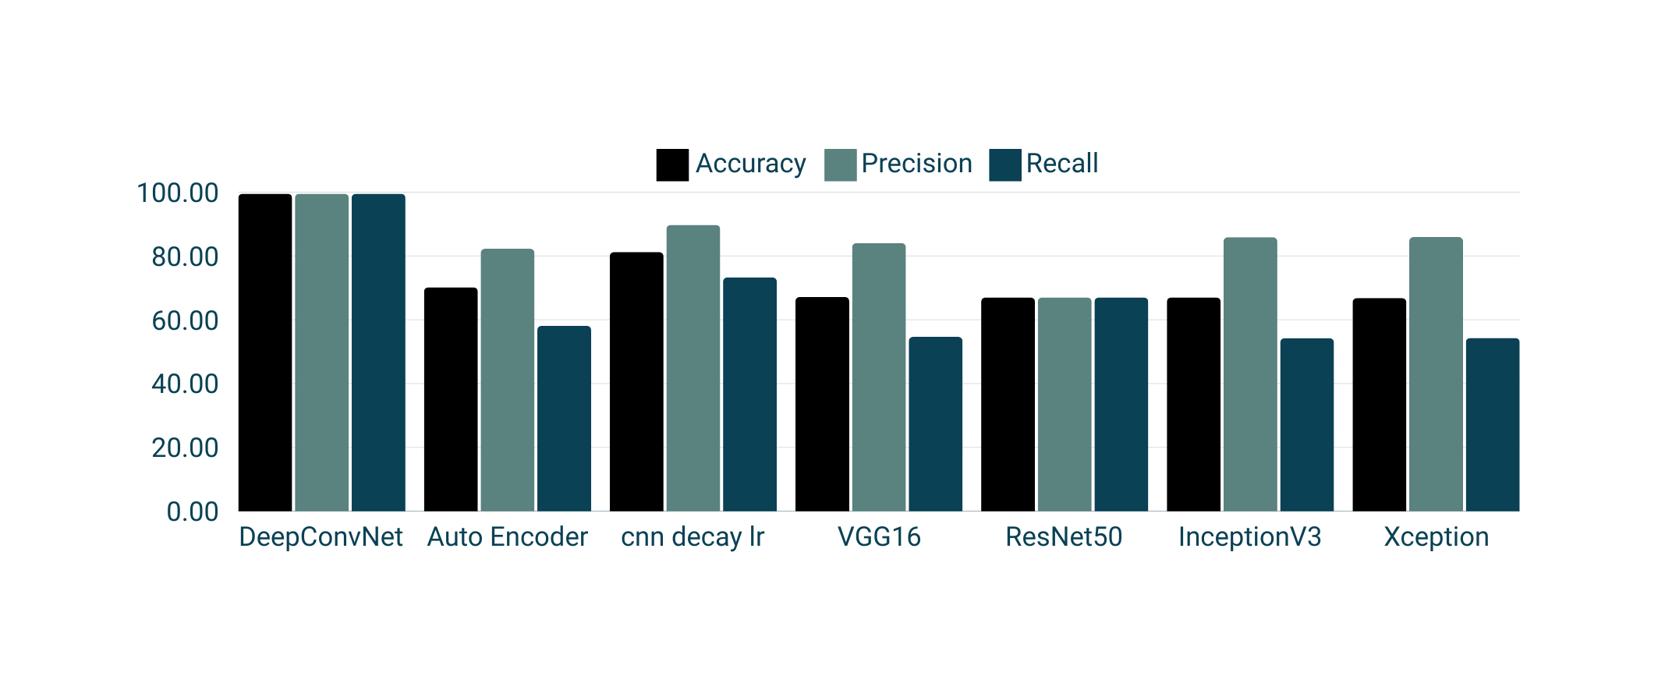
Training Results
The DeepConvNet performs better than the other models.

Slide 14
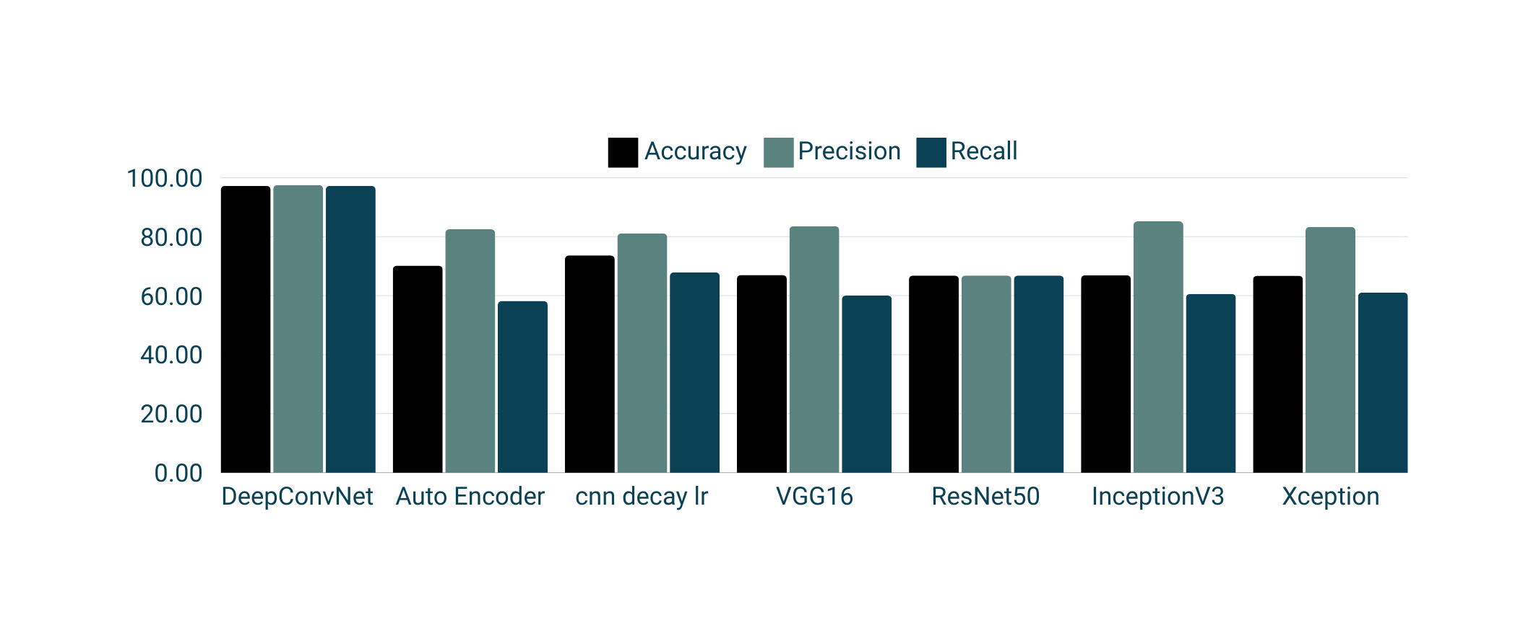
Testing Results
The DeepConvNet performs better than the other models.

Slide 15
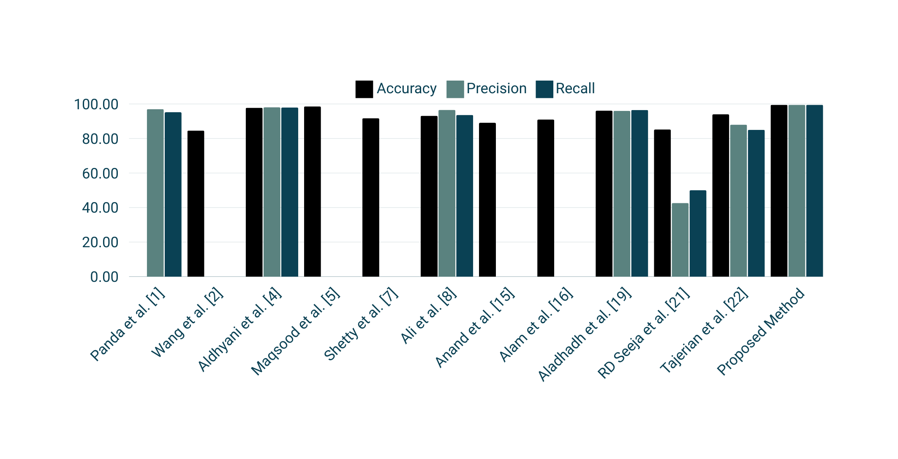
Paper Comparison Results
The Proposed Method performs better than the other papers.

Slide 16
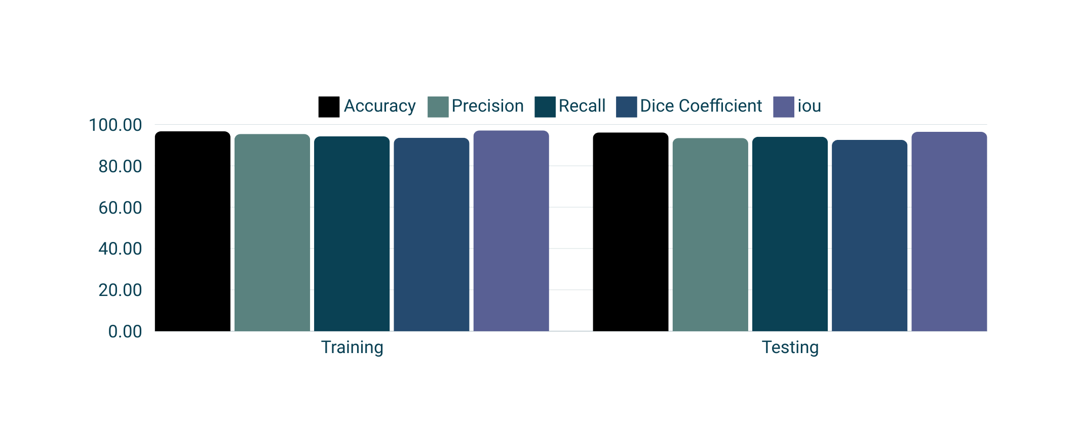
U_Net Results

Slide 17
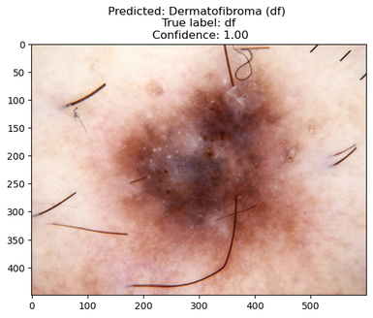
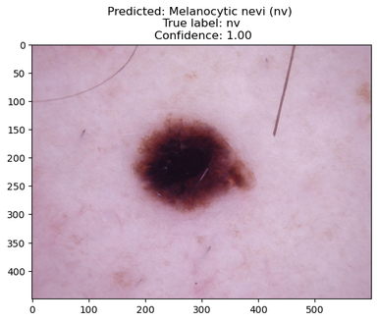
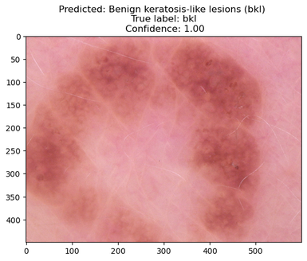
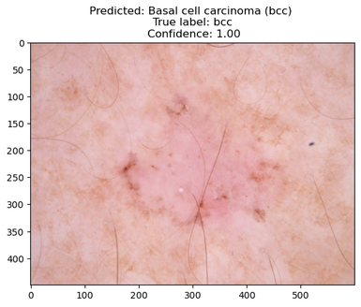
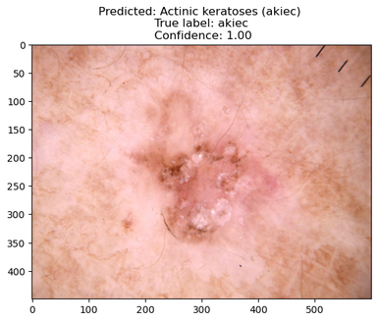
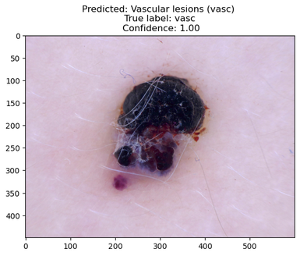
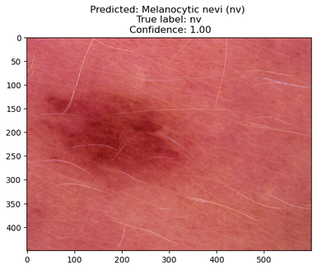
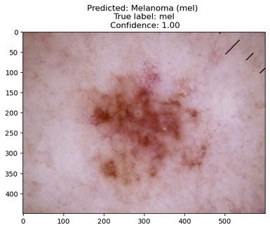
Sample of predictions
Back to Agenda Page
Classification | Segmentaion

Slide 18
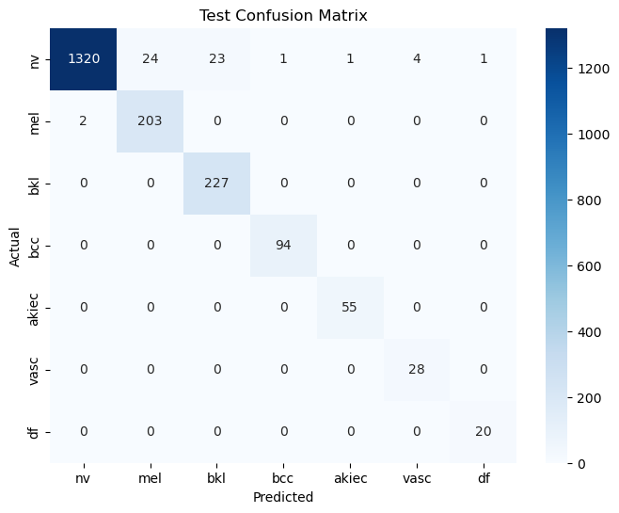
Analysis and Conclusion
Back to Agenda Page
Key Findings: Our study significantly improves skin cancer classification and segmentation using deep learning.
Performance: Achieved high accuracy, precision, and recall, outperforming existing methods.
Contributions: Integrated CNNs and segmentation techniques, optimizing data preprocessing and model architecture.
Acknowledgment: Gratitude to supervisors, collaborators, and the audience for their support.

Slide 19

International Journal of Telecommunications
Thank you!

